Slide 1


Spotify
Group-9

Slide 2
Upgrade
Group-9
Welcome
About Us
Our Teams
Welcome
Our Services
Business Intelligence And Data Integration-MIS 633
Developing a Data Warehouse and Business Intelligence System For Spotify
Play
Follow

Slide 3


Upgrade
Group-9
Welcome
About Us
Introduction
Our Teams
About Us
Our Services
Our project will focus on Spotify, the prominent music streaming service launched in 2008. With a freemium model, it offers both free and premium subscriptions, boasting a vast library of songs, podcasts, and other audio content. The platform's features include personalized recommendations, collaborative playlists, and social sharing.
Topic
Our Professor
Spotify
Joseph Morabito

Slide 4
Upgrade
Group-9
Welcome
About Us
Our Services
Our Teams
Our Services
Spotify operates on a freemium model, offering both free and premium subscription options. The free version is ad-supported and includes limitations, such as occasional ads and limited skips. The premium subscription removes ads, offers unlimited skips, and allows users to download music for offline listening. Spotify boasts an extensive library with millions of songs spanning various genres.
01
Business Dimensional Lifecycle
04
Opportunity Matrix
02
DW Bus Architecture Matrix
05
Prioritization Grid
03
High Level DW Bus Matrix
06
Detailed Bus Matrix

Slide 5
Upgrade
Group-9
Our Services
Welcome
About Us
Our Teams
07
Conformed Dimensions
13
Dimension Attribute Detail Descriptions
Our Services
08
Logical Fact Table Diagram
14
Transformation Rules for Revenue
09
Detailed Fact Table
15
Cube Design for Revenue
10
High Level Model Diagram
16
E-commerce Aggregate Tables
11
Star schema
17
E-commerce Cube
12
Dimension Table Detailed
Diagram
18
Detailed cube

Slide 6
Business Dimensional Lifecycle
Business
Requirements
Definition
Technology Track
Technical
Architecture
Design
Product
Selection &
Installation
Data Track
Project
Planning
Dimensional
Modeling
Physical
Design
Data Staging
Design &
Development
Deployment
Maintenance
& Growth
Application Track
End-User
Application
Specification
End-User
Application
Development
Project Management
Notes:
Project Planning – Scope of the project is defined
Business Requirements Definition – What are the Questions that the business needs to get answered, Detail Requirements Gathering
In our example the Company OrgX wants to know which clients are more profitable than others, How much do the employees cost us and do we have optimum utilization of our resources.
Dimensional Modelling – We build the Bus Matrix by identifying business processes and designing are fact tables.
6

Slide 7
DW Bus Matrix
Business Process/ Events | Date/Time | Location | Revenue | Currency | User | Employee | Product | Terms & Conditions
Creation | X | X |  |  |  |  | X
Production | X | X |  |  |  | X | X
Contract | X | X |  | X |  | X | X | X
Release | X | X |  |  |  | X | X | X
Analysis of song | X | X | X |  | X |  | X
Ranking | X | X | X |  | X |  | X
Billing & Invoicing | X | X | X | X | X | X |  | X
Ads Revenue | X | X | X | X | X
Revenue analysis | X | X | X | X | X | X | X
Strategy | X | X | X |  | X | X | X
Discount implementation | X | X | X | X | X | X | X | X
Limiting Access | X | X | X | X | X | X | X | X
Notes:
7

Slide 8
High Level DW Bus Matrix
High Level Enterprise DW Bus Matrix for Centralized and Consistent Data
 | Date/ Time | Location | Revenue | Currency | User | Employee | Product | Terms & Conditions
Billing and Invoices | x | x | x | x | x | x |  | x
Ads Revenue | x | x | x | x | x | x |  | x
revenue analysis | x | x | x |  | x | x | x
strategy | x | x | x | x | x | x | x
discount implementation | x | x | x | x | x | x |  | x

Slide 9
Opportunity Matrix
Business Process | Marketing | Finance | IT | Customer Support | Analytics
Billing and Invoices | x | x | x | x
Ads Revenue | x | x |  |  | x
Subs Revenue | x | x |  |  | x
strategy | x | x |  | x | x
discount implementation |  |  | x | x | x
Notes:
9

Slide 10
Prioritization Grid
High
BP2
BP5
BP3
Potential
Business Impact
BP4
BP1
Low
Low
High
Feasibility
Notes:
10

Slide 11
Detailed Bus Matrix
Sl.no | Business Process | Fact Tables | Granularity | Facts | Date | Location | Revenue | Currency | User | Employee | Product | Terms&Conditions
1 | Billing and Invoicing | User Billing | A unique identifier for each billing transaction | Subscription Charge, Subscription Duration | X | X | X | X | X | X |  | X
 |  | Invoice | a unique invoice | Amount paid | X | X | X |  | X | X |  | X
2 | Subscription Revenue | Subscription Revenue | unique subscription transaction | Net Revenue | X | X | X |  | X | X | X
 |  | Subscription Plan | unique subscription plan | Base Price | X | X | X |  | X | X
3 | Advertisement Revenue | Advertisement Revenue | unique advertising transaction | Total Cost | X | X | X |  | X | X |  | X
 |  | Ad Campaign | unique advertising campaign | Conversions | X | X | X |  | X | X |  | X
4 | Strategy | Strategic Performance | Specific time period or strategic initiative | Risk level | X | X | X | X | X | X | X
 |  | Stakeholder Engagement | interaction or engagement with stakeholders | Engagement Level | X | X | X | X | X | X
 |  | Strategic Resource Allocation | the allocation of resources to strategic initiatives | Budget | X | X | X | X | X | X
5 | Discount Implementation | Present Subscription Revenue | unique subscription transaction | Net Revenue | X | X | X | X | X | X |  | X
 |  | New Subscription Plan | unique subscription plan | Base Price | X | X | X | X | X | X |  | X

Slide 12

Conformed Dimensions
A dimension that has the same meaning across all fact tables to which it can be connected is called a conformed dimension. A replicated conformed dimension can be used in more than one DB space, or a single conformed dimension table can be used against many fact tables in the same DB space.
The Spotify instance we used the following Conformed Dimensions:
Date
Location
Revenue
Employee
User
Product
Terms & Conditions
Currency

Slide 13
Logical Fact Table Diagram
High Level Enterprise Data Warehouse Bus Matrix
User Billing cost fact table diagram with connected and disconnected dimensions
Artists
Date
User
Vendor
User
Billing
Fact Table
Grain:
Subscription Charge
(Per Month)
Expense
Location
Product
Genre
Playlist
Terms And Conditions
Revenue
Campaign
Owner
Currency
Employee

Slide 14
Spotify – Detailed Fact Table – Monthly user billing
High Level Enterprise Data Warehouse Bus Matrix
Monthly user billing fact table
Date_Key
Location_key
Revenue_key
Employee_key
User_key
Product_key
Terms &Conditions_key
Currency_key
Subscription_Duration
Subscription_Charge
Dimension Keys
- FK
The dimensions are the starting point of the fact table, which means that data is gathered for it..
The most atom level where the facts could be determined is represented by the grain of a fact table.
Notes:
14

Slide 15
High level Model Diagram
User
Date
Product
Location
User
Billing
Terms And Condition
Revenue
Currency
Employee

Slide 16

Star Schema - User Billing
User User ID (PK) Name Gender Age Email ID
Revenue Source Revenue source (PK) Service name Start date End date Customer segment
Time Time ID (PK) year quarter month Day hour minute
User billing
Time ID (FK) User ID(FK) Product/Service ID (FK) Location ID (FK) Revenue source ID (FK) Employee ID (FK) T&C ID (FK) Currency ID (FK) Subscription ID (FK) Subscription duration subscription charge
Product/service ID Product/Service (PK) Title Content format Duration Language Explicit content flag
Subscription Subscription ID (PK) Features Availability Policy Plan tier
Location Location ID (PK) Continent Country State/UT City/Town Zip code Longitude/Latitude
Currency Currency ID (PK) Name Numeric code Exchange rate Currency zone Symbol
Employee Employee ID (PK) Name Title/Position Department Contact Info.
T&C T&C ID (PK) T&C text Version No. Last updated date Acceptance status

Slide 17
Dimension Table Detailed Diagram : User Billing Dimension
year
(1)
(6)
Continent
Country
quarter
(4)
(176)
Currency
(4500)
State
month
(12)
Provinces
Day
(365)
City
Subscription
Plan
Hour
(8760)
(5)
Minute
(525600)
Zip code
Subscription
Charge
Seconds
(3153600)
Latitude\Longitude

Slide 18
Dimension Attribute Detail Descriptions
Attribute Name | Attribute Description | Cardinality | Slowly Changing Dimension Policy | Sample Values
Continent | Associate each transaction with the continent to which it belongs. | 6 | NOT UPDATED | 855221, 855222
Countries | Associate each transaction with its respective country. | 178 | NOT UPDATED | Sr. Business Services Manager, Delivery Manager, Project Lead
State/Union Territories/Provinces | Associate each transaction with its respective State/Union Territories/Provinces. | 4500 | NOT UPDATED | 001, 002, 003,004,005
Cities/ Towns | Associate each transaction with its respective City/Town. | - | NOT UPDATED | Active, Inactive, Temporary
Zip Code | Associate each transaction with its respective Zip Code. | - | NOT UPDATED | Health and Benefits, Retirement
Latitude/Longitude | Associate each transaction to its corresponding Latitude/Longitude. | - | NOT UPDATED | Brokerage, Consulting, Global Mobility.

Slide 19
Year | This Year attribute, typically denoted as "Year," allows you to analyze and understand discount patterns over different years. | 1 | NOT UPDATED | 2017
Quarter | This "Quarter" attribute allows you to analyze and understand discount patterns on a quarterly basis. | 4 | NOT UPDATED | Q1, Q2, Q3
Month | This attribute allows you to analyze and understand discount patterns on a monthly basis. | 12 | NOT UPDATED | April
Day | This attribute allows you to analyze and understand discount patterns on a daily basis. | 365 |  | 15 August
Hour | This attribute allows you to analyze and understand discount patterns on an hourly basis. | 8760 |  | 12:31
Minute | This attribute would represent the minute of the hour during which the discount transaction occurred | 525600 |  | 12:31

Slide 20
Transformation Rules for Revenue
Column | Detail
Date | Transform: YYYYMM
Location | Transform: Country
Revenue Source | Derive: Sum of Revenue
Employee | Drop
User | Derive: Sum of users
Product | Drop
Terms and Conduction | Move
Currency | Derive: Total Revenue/Conversion Rate
Notes:
Business Needs - i.e., information content - transforms, derivations, etc.
20

Slide 21
Cube Design for Revenue
Dimension | Type | Sparsity
Revenue | Fact | Always Dense Design to be chosen at Client or Project Dimension
Time | Dimension | Always Dense: By Full year, or Quarter, or Month
User | Dimension | High Sparsity: NO user will have revenue for the month
Product | Dimension | Dense: Every Product will have it (CHECK AGAIN)
Location/Currency | Dimension | Dense: Every Location/Currency will have it
Dense | Dimension | Dense: Every Dense will have it (CHECK DIMENSION)
Project | Dimension | High Sparsity: Not every Client/Project will have revenue for the month (CHECK DIMENSION)
Notes:
21

Slide 22
E-commerce Aggregate Tables
Location
Continent
Country
State/Province
City/Town
Zip code
Longitude
Latitude
Revenue
Revenue source
Product/service
Name
Type
USER BILLING
Subscription charge
# of users
Net profit
Net revenues
Location
Continent
Country
USER BILLING
Subscription charge
No. of users
Net profit
Net revenues
Time
Year
Quarter
Month
Date
Year
Quarter
Month
Hour
Minutes
Seconds
User
Name
Gender
Age
Email ID
2-way aggregate table: Sum of revenue over time dimension and country dimension
Revenue
Product/Service

Slide 23
DW Bus Architecture Matrix
Business Process/Events | Date/Time | Location | Revenue | Currency | User | Artist | Employee | Product | Terms & Conditions
Creation |  | X |  |  |  | X |  | X
Production | X | X |  | X |  | X |  | X
Contract | X | X |  | X |  | X | X | X | X
Release | X | X |  | X | X | X | X | X
Analysis of song | X | X |  |  | X | X | X | X
Ranking | X | X | X |  | X | X | X | X
Billing & sub. | X | X | X | X | X |  | X |  | X
Ads revenue | X | X | X | X | X |  | X |  | X
Revenue analysis | X | X | X | X | X |  | X | X
Strategy | X | X | X | X | X | x | X | X
Discount implementation | X | X | X | X | X |  | X |  | X
limiting access | X | X | X | X | X |  | X | X

Slide 24

CUBE
Partnership
Subscription
Ads
MONTH1
MONTH 2
UK
MONTH 3
INDIA
USA

Slide 25



Partnership
Subscriptions
UK
ADS
INDIA
USA
USA
M3
M1
ADS
M2
M1
M2
M3
SLICE
ROLL- UP
UK
Partnership
INDIA
Subscription
M1 M2
USA
USA INDIA UK
ADS
DICE
PIVOT

Slide 26
User And Task Analysis
Free Users: Users who access Spotify for free, supported by advertisements.
Delivery: Ad-supported streaming, limited skips, and lower audio quality.
Premium Users: Subscribers who pay for the Premium service.
Delivery: Ad-free streaming, higher audio quality, offline downloads, unlimited skips, additional features like cross-device, syncing.
Student Plan Users: Premium users who are eligible for discounted student plans.
Delivery: All Premium features at a reduced rate for eligible students.
Podcast Listeners: Users who primarily use Spotify for listening to podcasts.
Delivery: Access to a diverse range of podcasts on various topics.
Business Analyst: OLAP, Portal
Executive/Manager: OLAP, Reports
Designer: OLAP, Portal

Slide 27
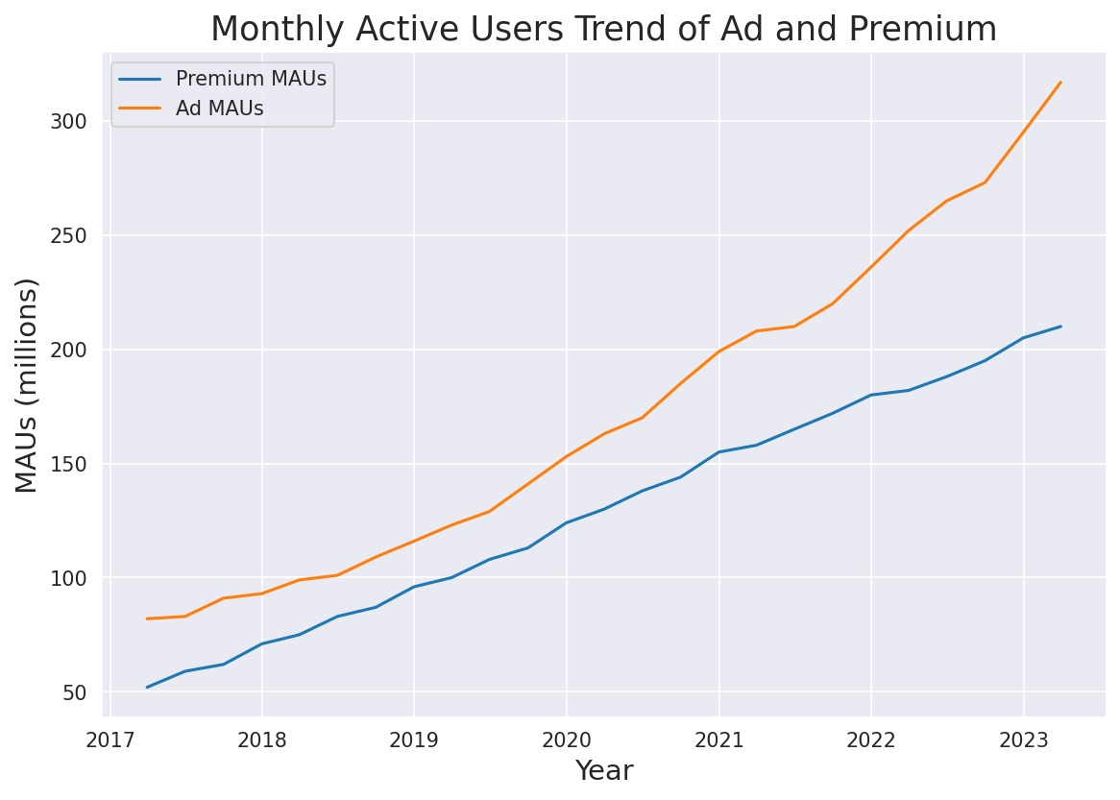
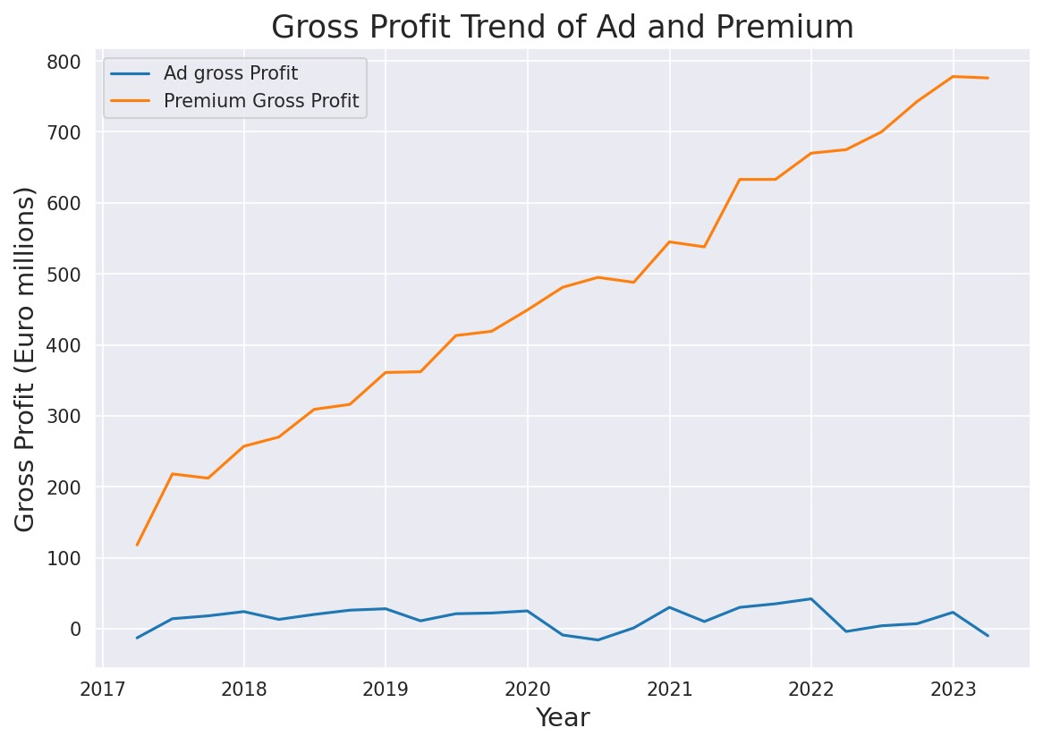

Slide 28
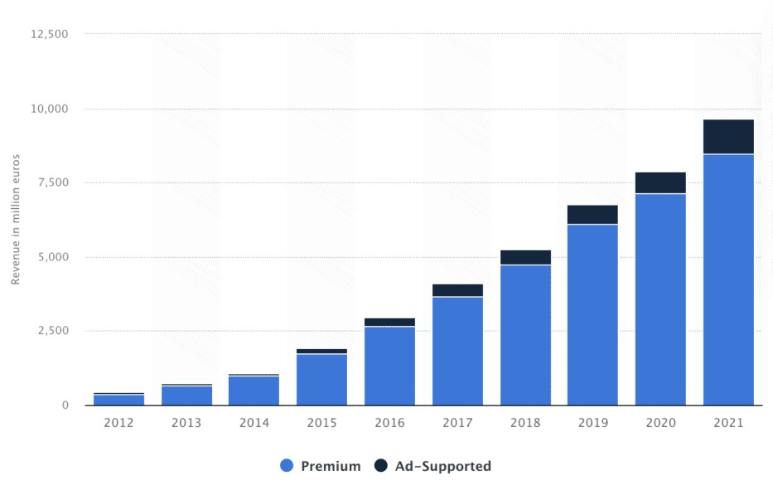
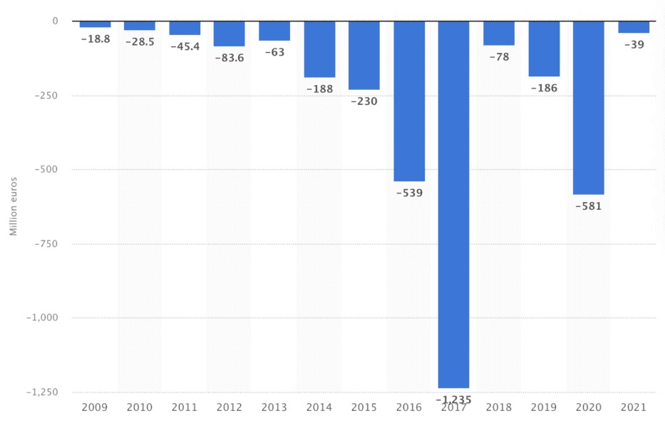

Slide 29
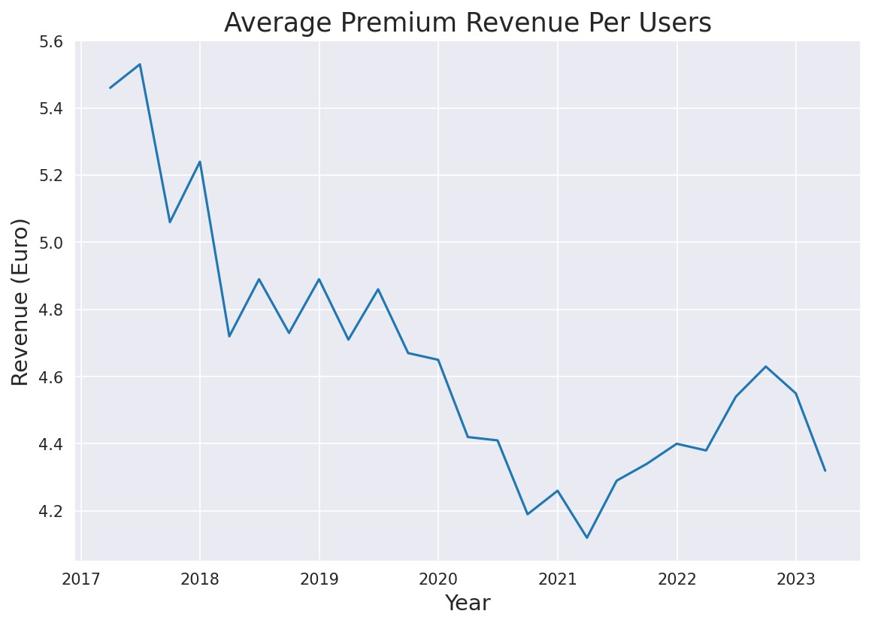
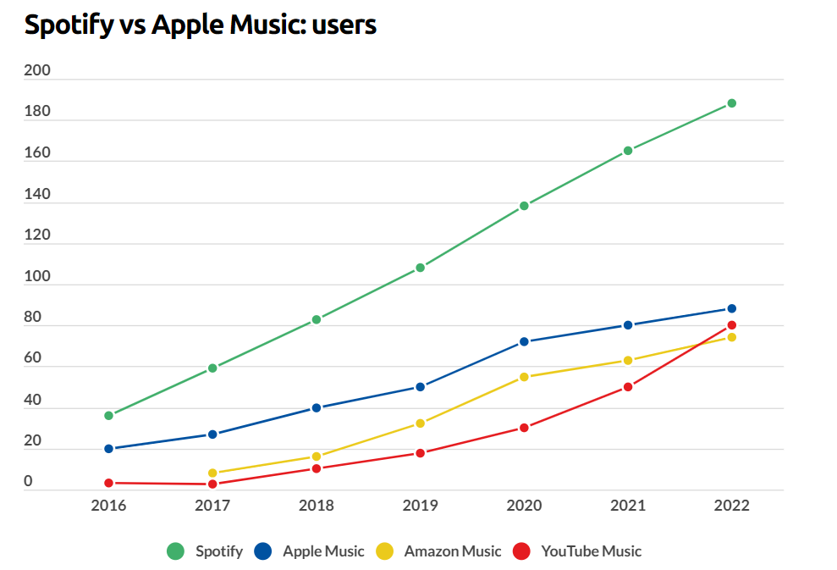

Slide 30
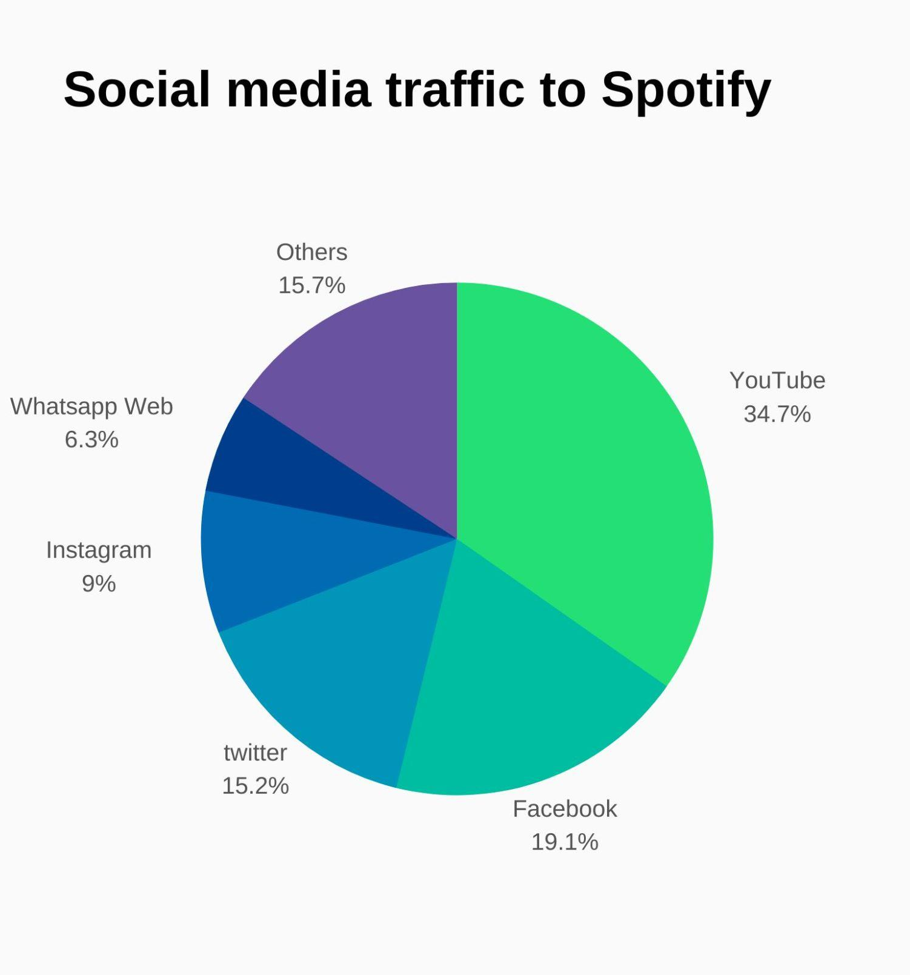
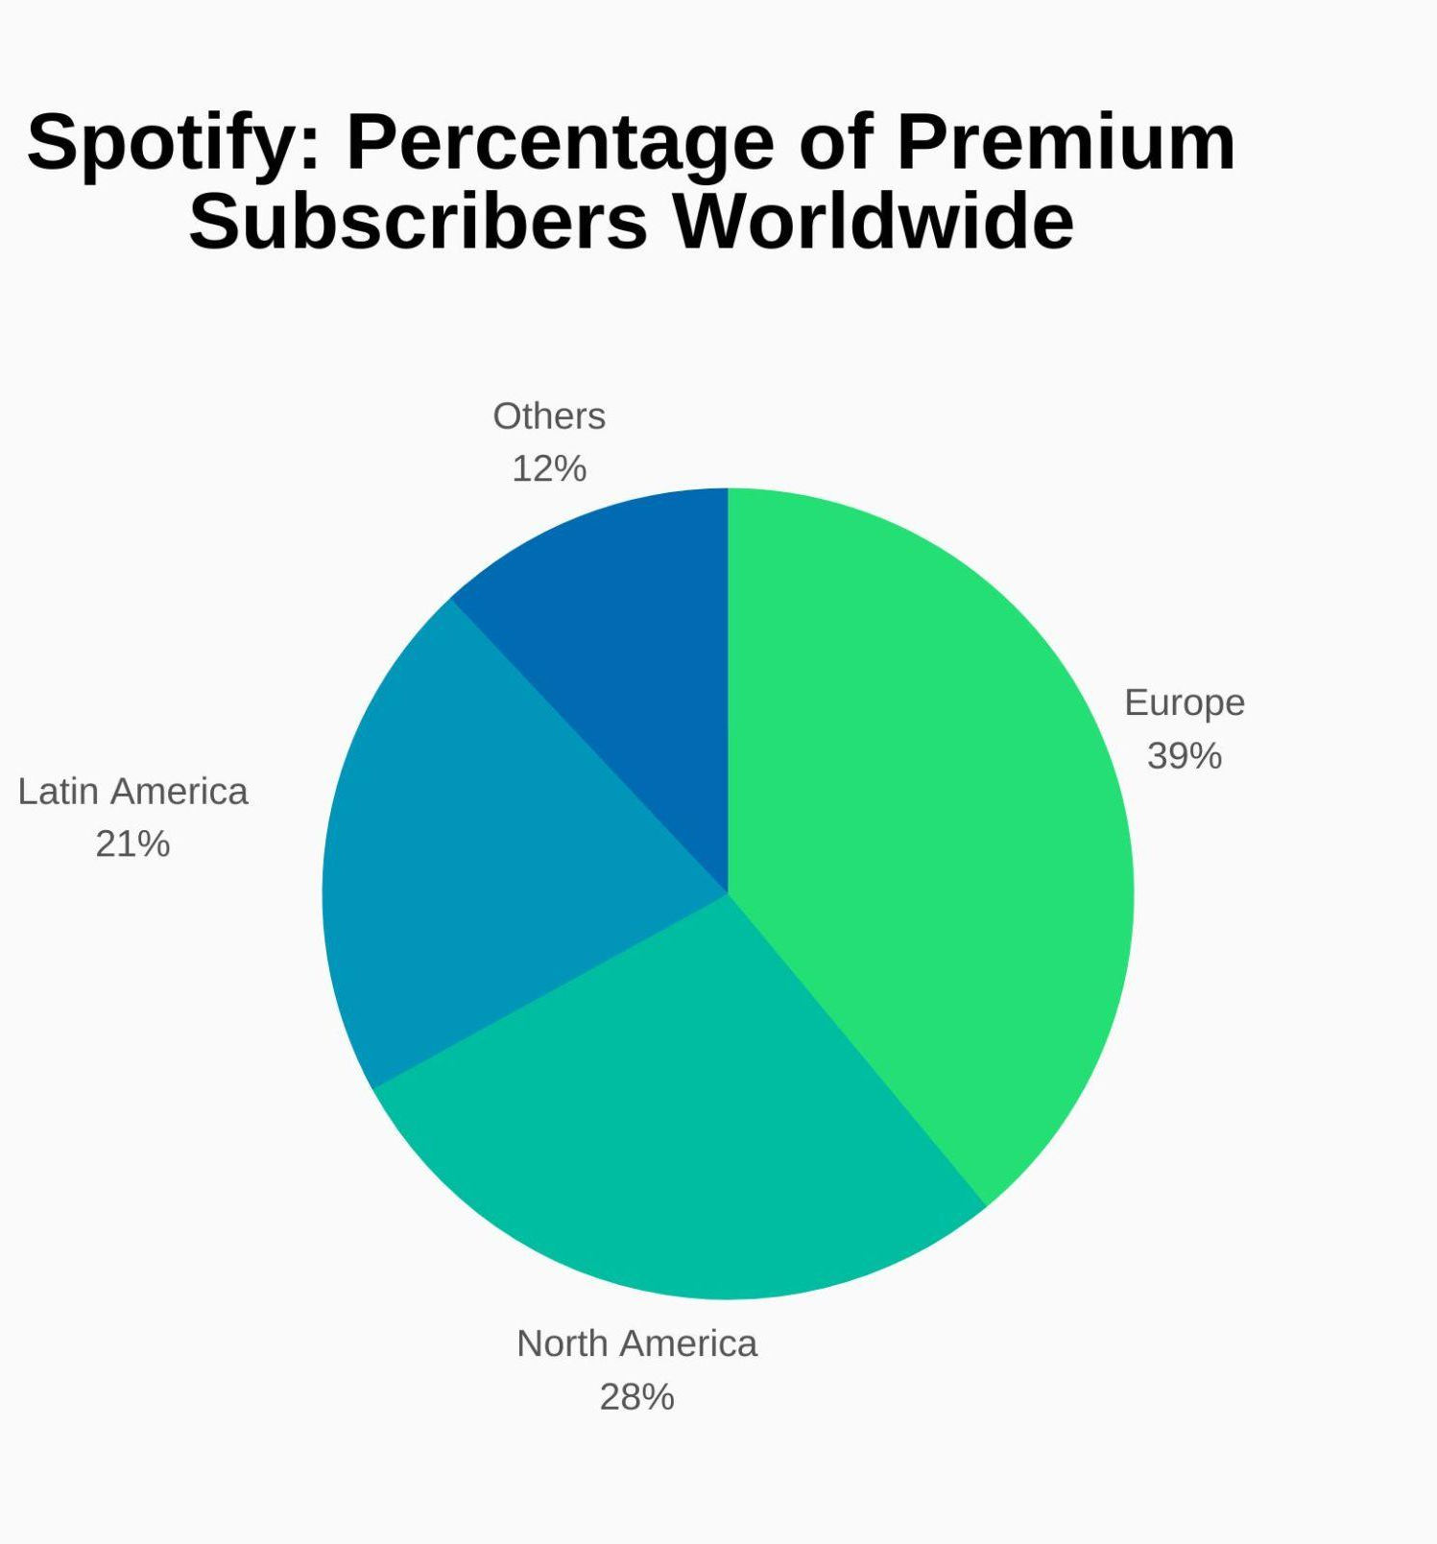

Slide 31
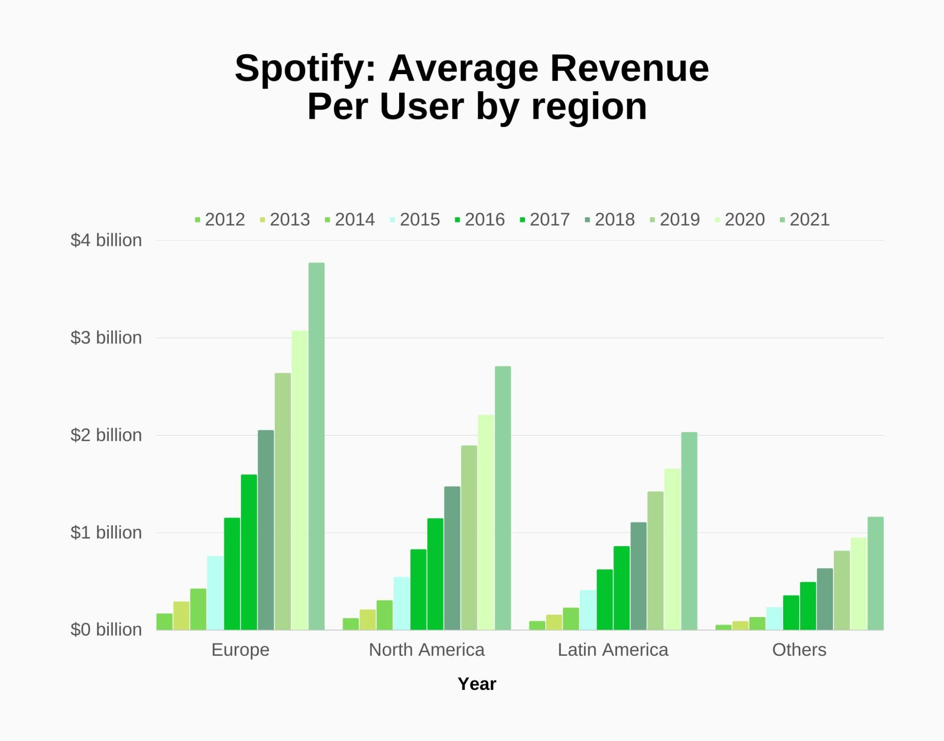
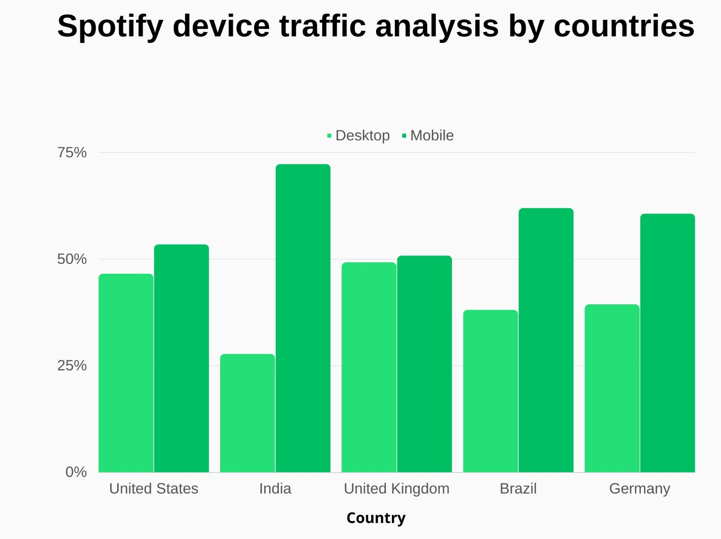

Slide 32


Upgrade
Group-9
Welcome
About Us
Best prices
Our Teams
Pricing
Our Services
Mini
Individual
Duo
From Rs.7/day
Rs. 117/month
Rs. 149/month
Ad-free music listening
Group Session
Song downloads
30 songs
10k songs
10k songs
No. of Devices
1 mobile
5 devices
5 devices per account

Slide 33
References:
https://www.usesignhouse.com/blog/spotify-stats
https://www.kaggle.com/code/somnath2/spotify-revenue-and-expense-analysis
https://www.searchlogistics.com/learn/statistics/spotify-statistics/

Slide 34


Thank You
Group-9
Final Project
0:23
-3:39

